Slide 1
Data Sonification The art of turning numbers (data) into sound through program/code
Dr. Kayalvizhi Jayavel

Slide 2
Can you give some examples for Data?

Slide 3
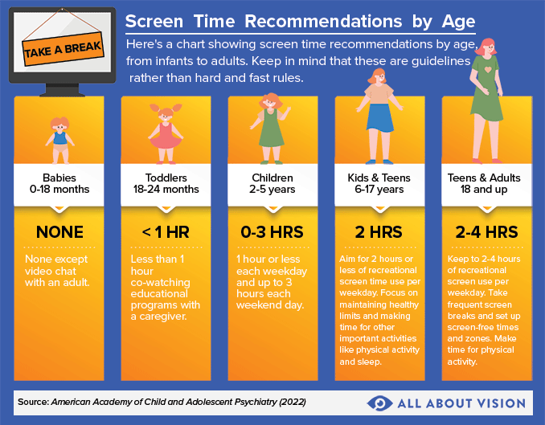
How is data usually represented?

Slide 4
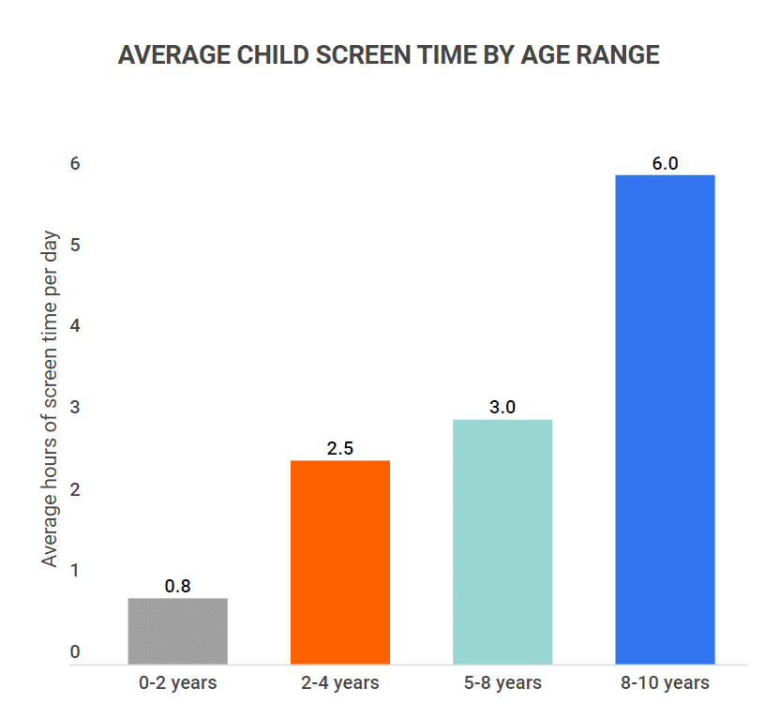
Visuals
Image credit: https://www.zippia.com/advice/average-screen-time-statistics/

Slide 5
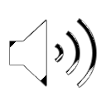
Audio?
Was there any data?

Slide 6
What are we trying to do?
We are going to write a code that takes a list of numbers and turns each number into a sound pitch.
Example:
how many people boarded in each bus stop or
how many empty seats at each bus stop
Each number is played for a specific duration of time (eg: half a second, one after another, so we can hear the data.
Small numbers → low sounds
Big numbers → high sounds

Slide 7
Who can be benefitted from this data sonification?
- Any thoughts?

Slide 8
Who can be benefitted from this data sonification?
Helping visually impaired users
Making art with data
Data ---> Music

Slide 9

Libraries- Tools in ToolBoxes
Bela.h → lets us work with real-time audio on the Bela board
cmath → gives us maths functions like sin()
vector → lets us store a list of numbers that can change size

Slide 10
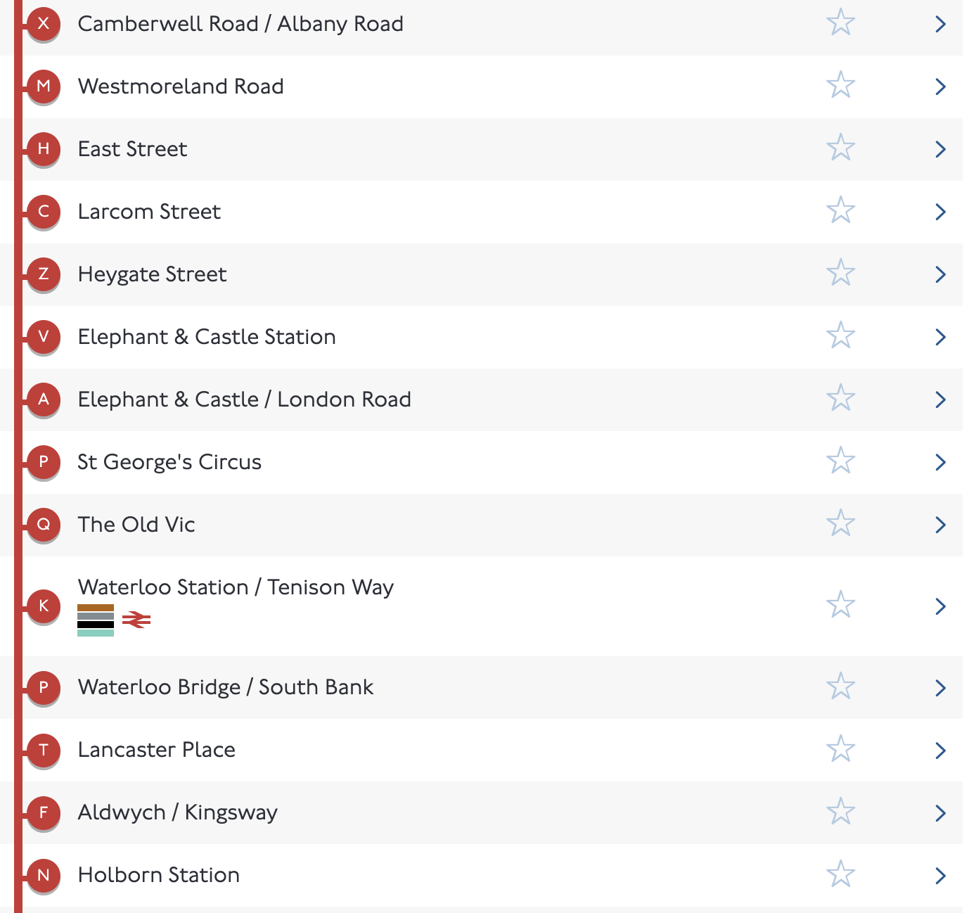
Vector: List
std::vector<float> data = {2, 5, 7, 3, 9, 4, 6};
data = {2, 5, 7, 3, 9, 4, 6} → This is our dataset.
Each number could represent “how many people boarded in the first 7 bus stops in the route from High Holborn to Peckham in the 68 bus route to West Norwood”
We will play one sound for each number

Slide 11

Variables for sound and timing
data = {2, 5, 7, 3, 9, 4, 6};
What pitch or how high or low (frequency) for each data point?
Which data point (current index) are we in now?
How long to play music for each data point (samples per event)?
How do we know we have reached end of the data points (eg: 7th bus stop- counter)?

Slide 12
Variables for sound and timing
data = {2, 5, 7, 3, 9, 4, 6};
What pitch or how high or low (frequency) for each data point?
float frequency = 220.0;
Which data point (current index) are we in now?
int currentIndex = 0;
How long to play music for each data point (samples per event)?
int samplesPerEvent;
How do we know we have reached end of the data points (eg: 7th bus stop- counter)?
int counter = 0;

Slide 13
Variables for sound and timing
float phase = 0;
phase → keeps track of where we are in a sound wave
float frequency = 220.0;
frequency → how high or low the sound is (pitch)
int currentIndex = 0;
currentIndex → which number in the data we are using
int samplesPerEvent;
samplesPerEvent → how long each number lasts (in samples)
int counter = 0;
counter → counts audio samples so we know when to move on

Slide 14
Set up function
bool setup(BelaContext *context, void *userData) {
samplesPerEvent = context->audioSampleRate * 0.5;
return true; }
This runs just once
audioSampleRate is how many sound samples happen per second
We multiply by 0.5 so each data point lasts half a second

Slide 15
Render function
data = {2, 5, 7, 3, 9, 4, 6};
for(unsigned int n = 0; n < context->audioFrames; n++) {
// This runs again and again. This loop runs once for each audio sample. audio is built one tiny piece at a time
if(counter++ >= samplesPerEvent) { counter = 0; currentIndex = (currentIndex + 1) % data.size();
// When half a second has passed: Reset the counter and move to the next number in the data; % data.size() makes sure we loop back to the start when we reach the end

Slide 16
Turning numbers to pitch
data = {2, 5, 7, 3, 9, 4, 6};
float value = data[currentIndex];
frequency = 200.0 + value * 60.0;
This is the most important idea:
We take a number from the data
// data = {2, 5, 7, 3, 9, 4, 6}
We convert it into a sound frequency
Example:
Value = 2 -> low pitch
Value = 9 -> much higher pitch
Bigger the number -> Higher the sound

Slide 17
Making the sound wave- Sine
float out = sinf(phase * 2.0f * M_PI);
sin() creates a smooth sine wave
Sine waves sound clean and simple
phase += frequency / context->audioSampleRate;
if(phase >= 1.0)
phase -= 1.0;
This moves the wave forward at the right speed
Higher frequency -> wave moves faster -> higher pitch

Slide 18
Send sound to speaker
for(unsigned int ch = 0; ch < context->audioOutChannels; ch++) {
audioWrite(context, n, ch, out * 0.2); }
Sends the sound to all speakers

Slide 19
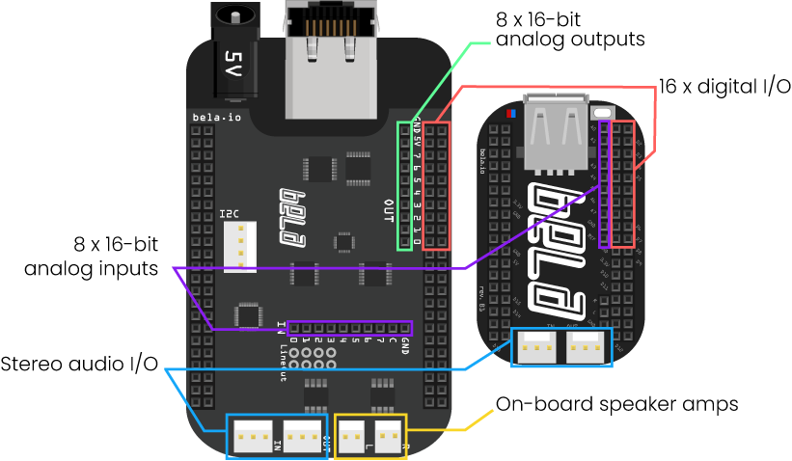
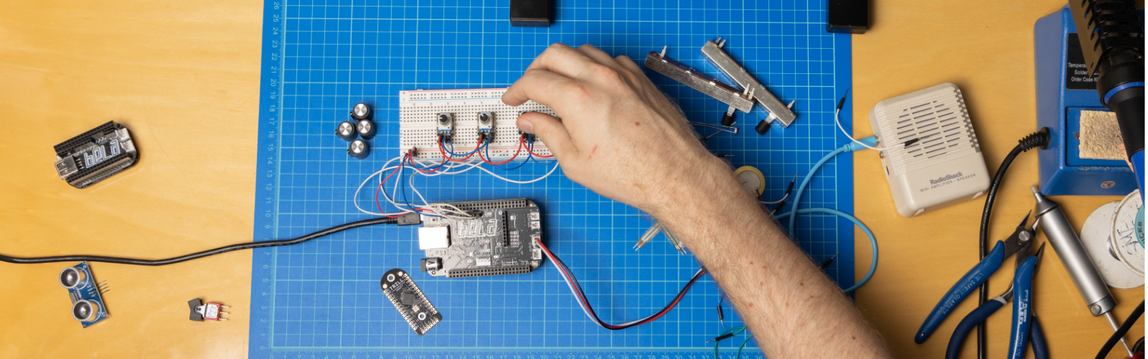
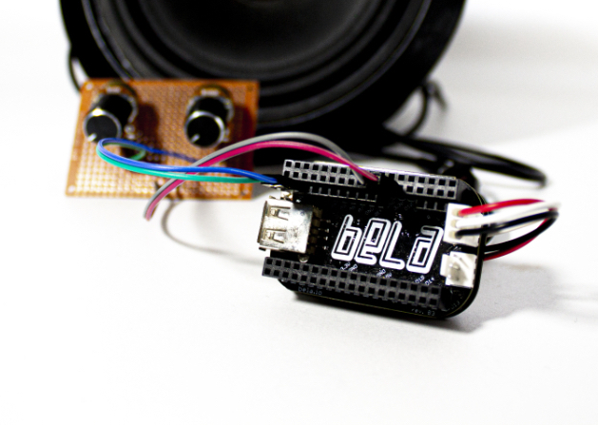

BELA
Embedded system (mini-computer)
Analog and digital I/O
Ultra-low latency
Audio capabilities

Slide 20
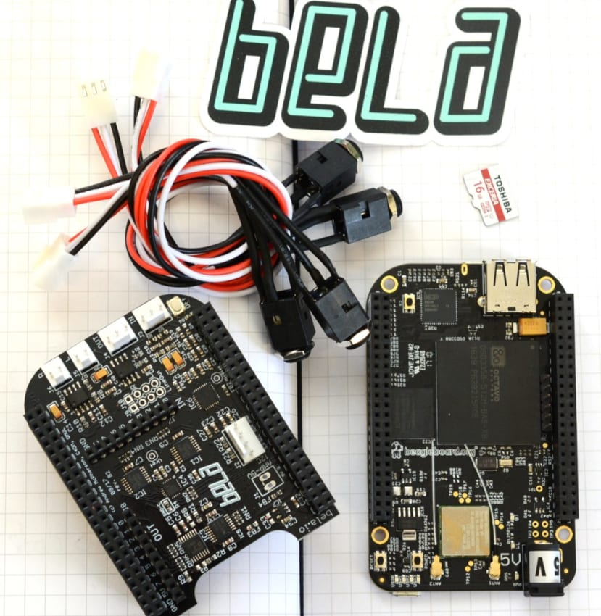
Bela- Microcontroller with Audio capabilities

Slide 21

Slide Acknowledgement
The following slides are provided by Dr. Teo Dannemann
THANK YOU!!!

Slide 22
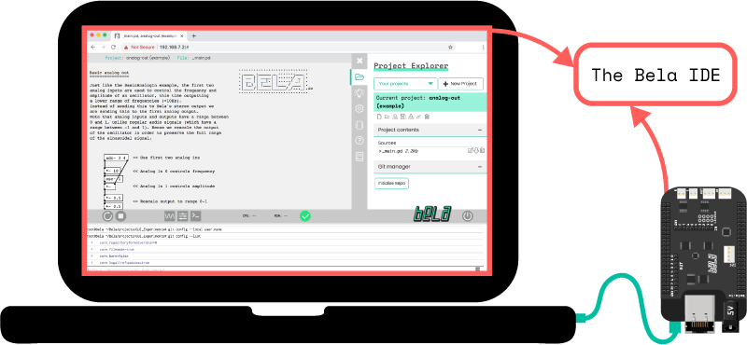

Slide 23
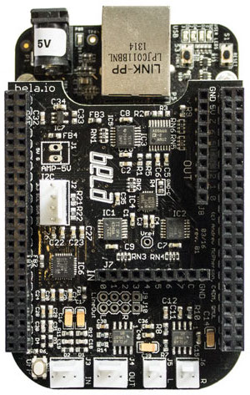
Let’s start!
1. Connect your Bela unit to your computer using the appropriate USB cable and wait for it to boot up. When BELA is ready the blue LEDs will blink in a heartbeat pattern.
2. Connect speaker to the speaker OUT using the two jumper cables

Slide 24
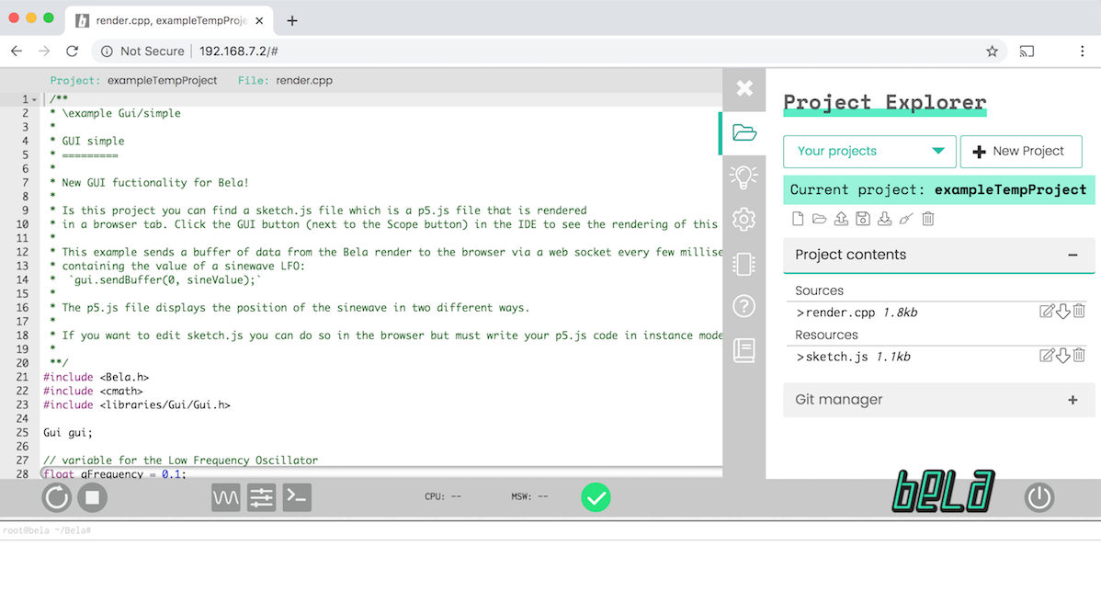
3. Go to http://bela.local
You should see something like this:

Slide 25
Let’s explore some examples:
Using sensors:
Trill sensor
Bar
Hexa
Square

Slide 26
Let’s explore some examples:
Simple sinewave with different frequencies
Using samples: sequencer
Using sensors: trill sensor
Ring trill

Slide 27
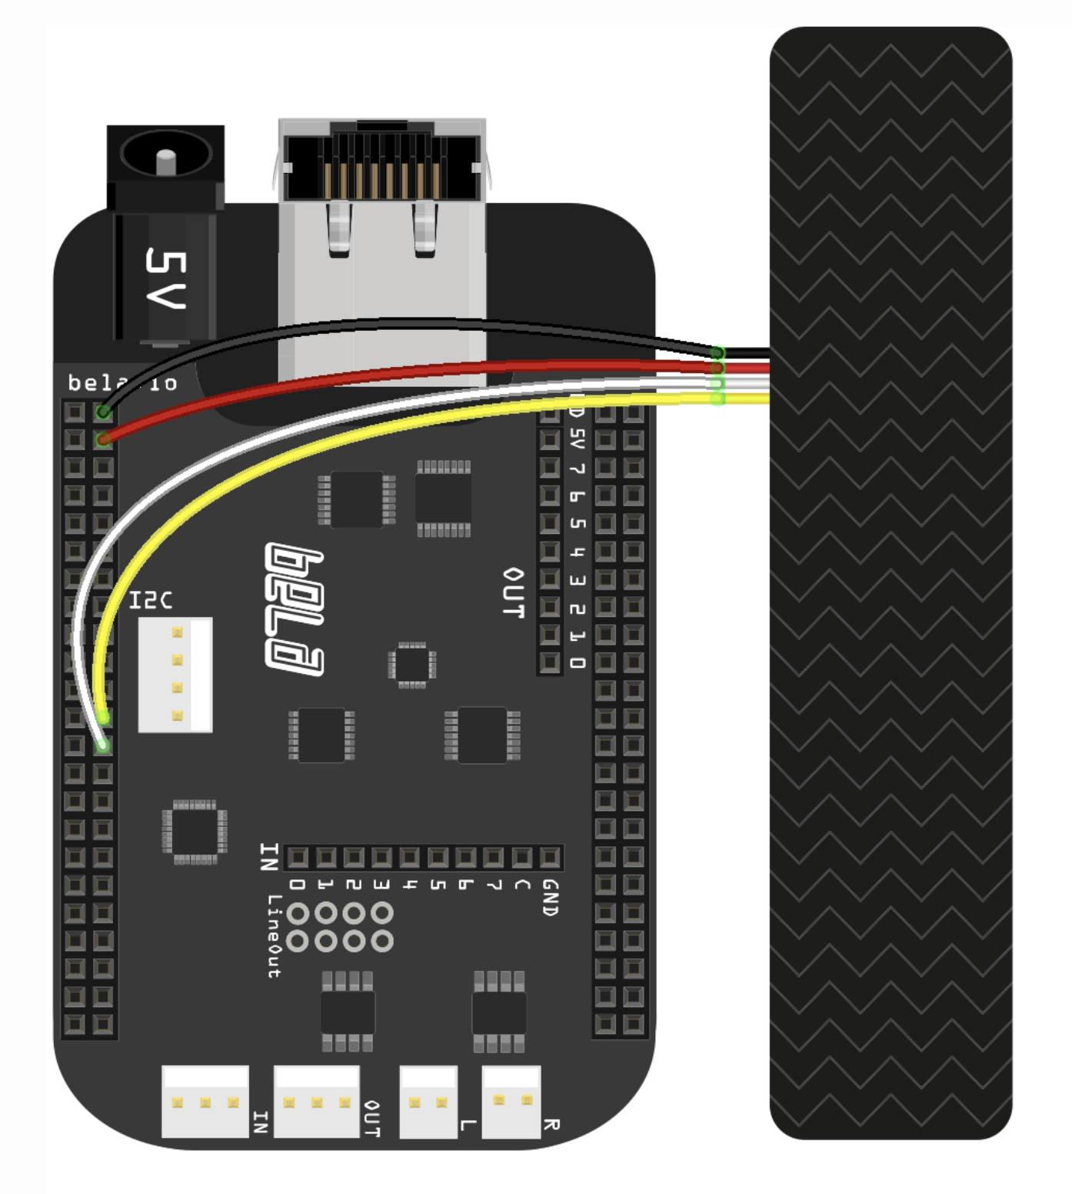
Trill sensor
Connect the cables following the diagram
In the IDE, go to Examples > Trill > bar-sound
Click the Build & Run button at the bottom left

Slide 28
Activity time!
Gather in groups of four and go around your area to explore. The goal is to collect some data that you will then input into Bela to make sound from it. We will have pre-prepared code in Bela, so you don’t have to know technicalities on music or sound, just focus on how to feed the data to the code.
Examples to get inspired:
Count pedestrian’s steps per minute and create a rhythm.
Map student counts per year to pitch of notes.
Count time in traffic lights and turn them into rhythms

Slide 29
Activity time!
Gather in groups of four and go around your area to explore. The goal is to collect some data that you will then input into Bela to make sound from it. We will have pre-prepared code in Bela, so you don’t have to know technicalities on music or sound, just focus on how to feed the data to the code.
Examples to get inspired:
Record sounds of various sources (bus, wind, steps) and mix them in a sound composition.
Interviewing pedestrians about their favorite songs and then mix them.
Record ambulances or other loud sound sources and play with differences in volumes

Slide 30
Activity time!
Goal: The goal is to collect some data that you will then input into Bela to make sound from it.
5 minutes discussion of ideas in groups
10 minutes to go around this room/3rd floor and collect (or record) data
Inspirations:
Tell them about three or four songs and record the most to least popular ones by count
Tell them about four or five travel destinations and record the most to least favorite by count
Observe the count of plants by type
10 minutes to develop your compositions
We will have pre-prepared code in Bela, so you don’t have to know technicalities on music or sound, just focus on how to feed the data to the code.

Slide 31
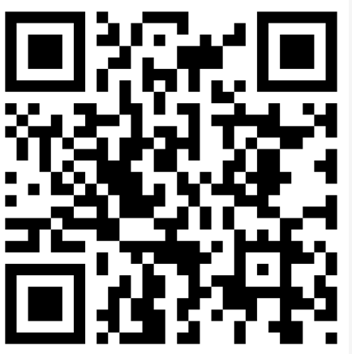
Code Base and Audio Files
Access this link: https://github.com/kjayavel/Bela/

Slide 32
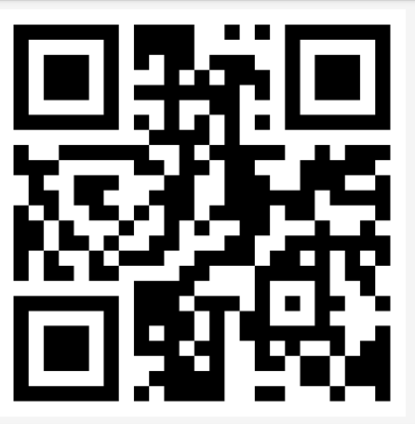
Bela website
http://bela.local/

Slide 33
Final points and close

Slide 34
Final points
Hope to see you soon!!!
My contact details:
Kayalvizhi Jayavel Ph.D, PGCERT, FHEA Course Leader and Senior Lecturer |
BSc Data Science and AI She/Her k.jayavel@arts.ac.uk

Slide 35
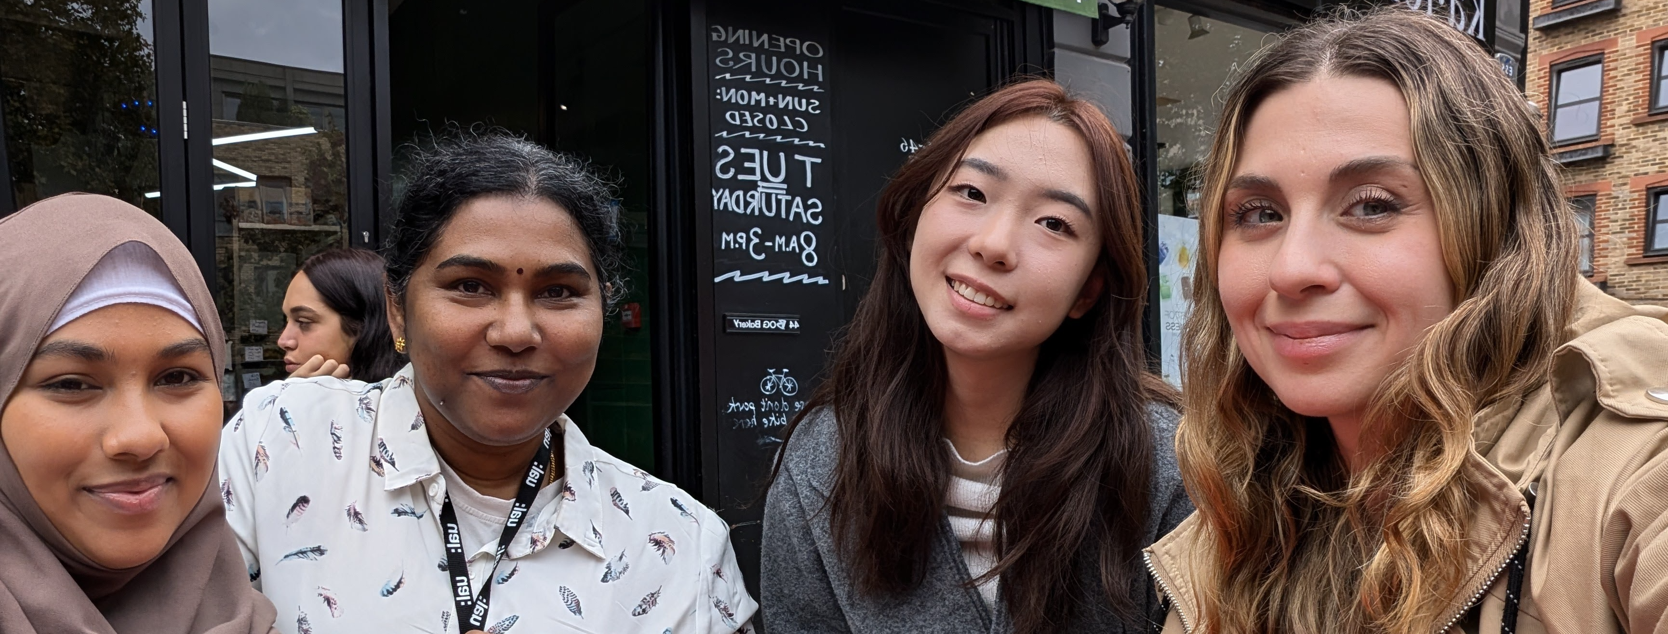
THANK YOU

